Slide 1
Library management system
Presented By: Venugopal Kodavatikanti
Banner Id: 000795791

Slide 2
Index
Introduction
Objectives
Scope
Product Perspective
Product Functions
Key Stakeholders
Constraints
Assumptions & Dependencies
Requirements – Functional & Non-Functional
Implementation
Conclusion

Slide 3
introduction
Library management system plays a very important role to maintain the library like managing the book inventory, making all the available books visible to the students, allowing the student to borrow the book and ensure that they return the book on time.
In case of any delay in returning the book, system should also apply some fine amount on the student. System should allow the librarian to add new book in the inventory and also manage its status.
We have used Web technologies like PHP, SQL, HTML, CSS, etc to design and implement this library management system.

Slide 4
Objectives
The main objective of this library management system project is to ensure that assets of library are managed effectively and efficiently.
System should effectively manage all the books present in the library like the current status of the book whether it is borrowed or in damaged condition.
System should also charge applicable fines on the student if they fail to return the book on time.

Slide 5
Scope
User Management
Book Management
Borrow Book
Return Book
Fine Management
Book copy status Management

Slide 6
Product functions
User Registration & Login
Add books in the inventory
Update / Delete book
Update book copy status
Available / Borrowed / Damaged
Raise request to borrow book
Approve borrow requests from Students
Calculate and display fines
Pay fine & Return borrowed book

Slide 7
Key stake holders
Internal Stakeholders
Students
Librarians
Teachers
Alumni
Administartors
External Stakeholders
Book vendors
Researchers

Slide 8
constriants
System login only available for Students and Librarians
Integrate Payments for fine collection
Integrate Email notification for sending important communication
Add option to filter books based on genres
Allow access to book vendors for adding books in the inventory
Generate reports

Slide 9
Assumptions and Dependencies
Users will have internet connection to access the system
There will be enough library staff to manage the book inventory
System is dependent on server resources like minimum 2GB RAM, 4 cores CPU, OS, etc.

Slide 10
Functional requirements
Role based access control
Only Authorized user can access the system
Books can be added / updated / deleted from the database
Current status of each book copy should be maintained
Students should be able to borrow/ return books
Librarians should be able to approve borrow requests.
Fine should be automatically calculated and displayed to the students

Slide 11
Non-functional requirements
System should be always available
System should have good user interface
System should provide high performance means quick response
System should be secure, only authorized users should have access
Data should be always latest updated one

Slide 12
Technologies used
PHP
SQL Database
HTML
CSS
Bootstrap

Slide 13
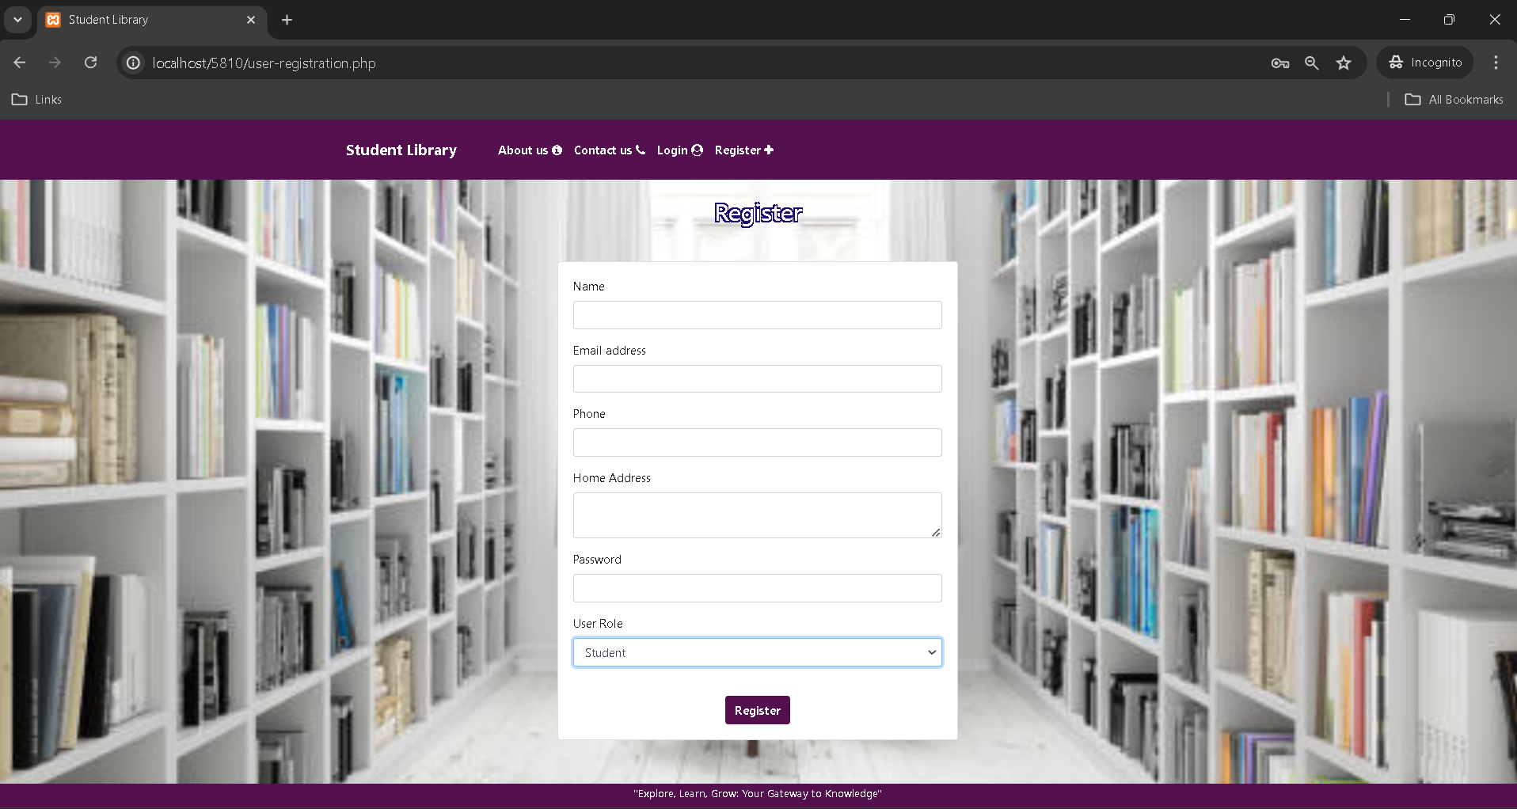
Screenshots of implementation

Slide 14
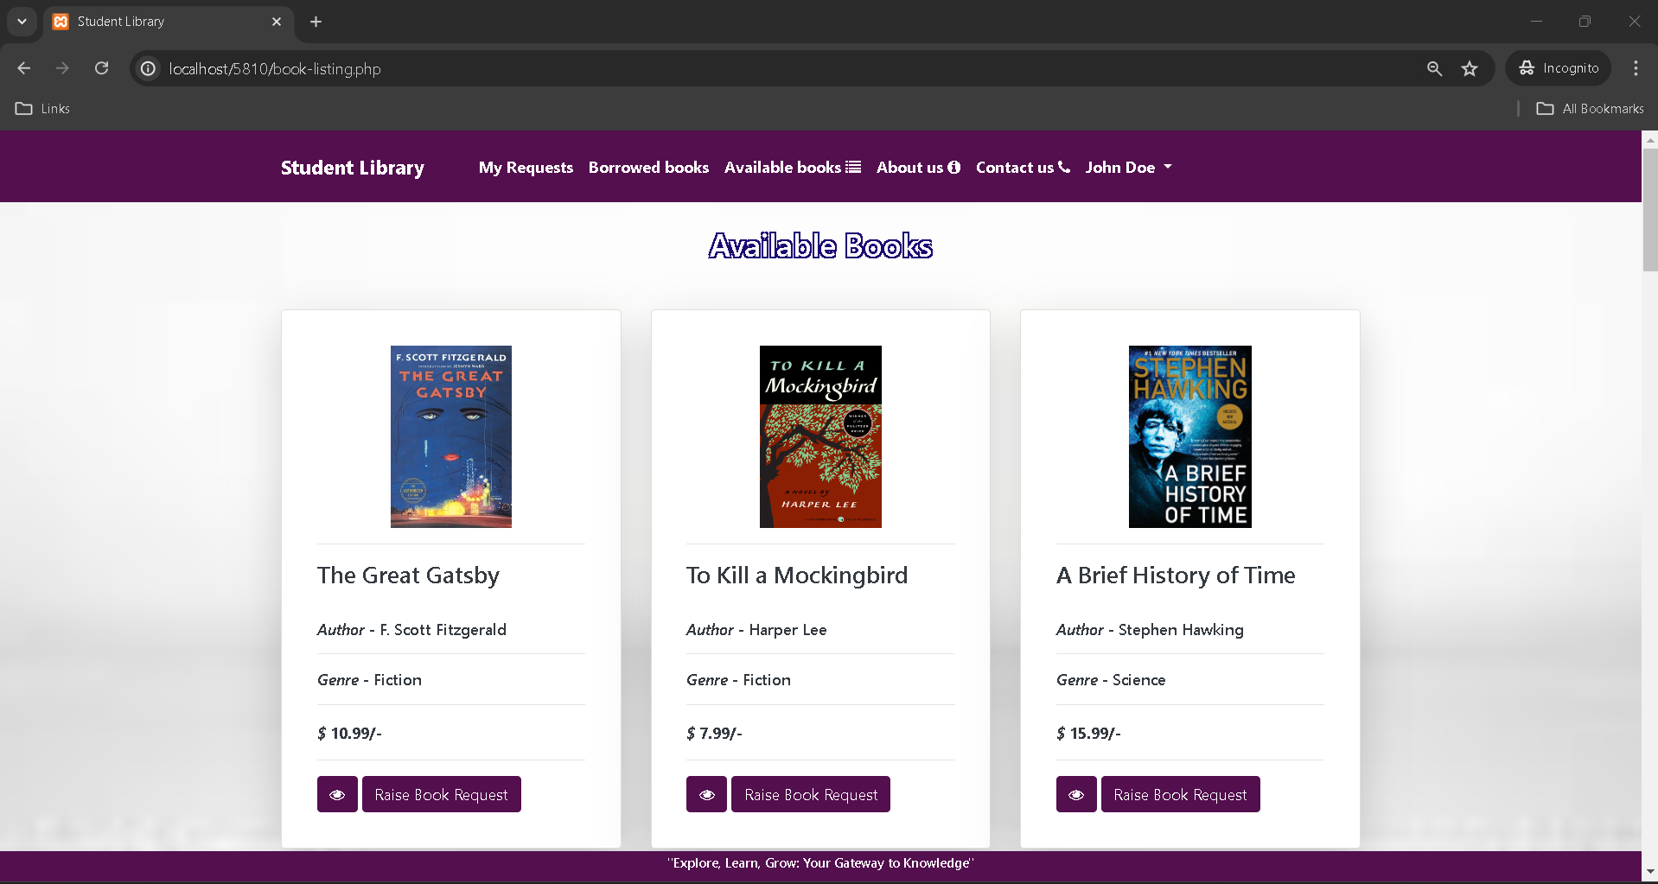
Screenshots of implementation

Slide 15
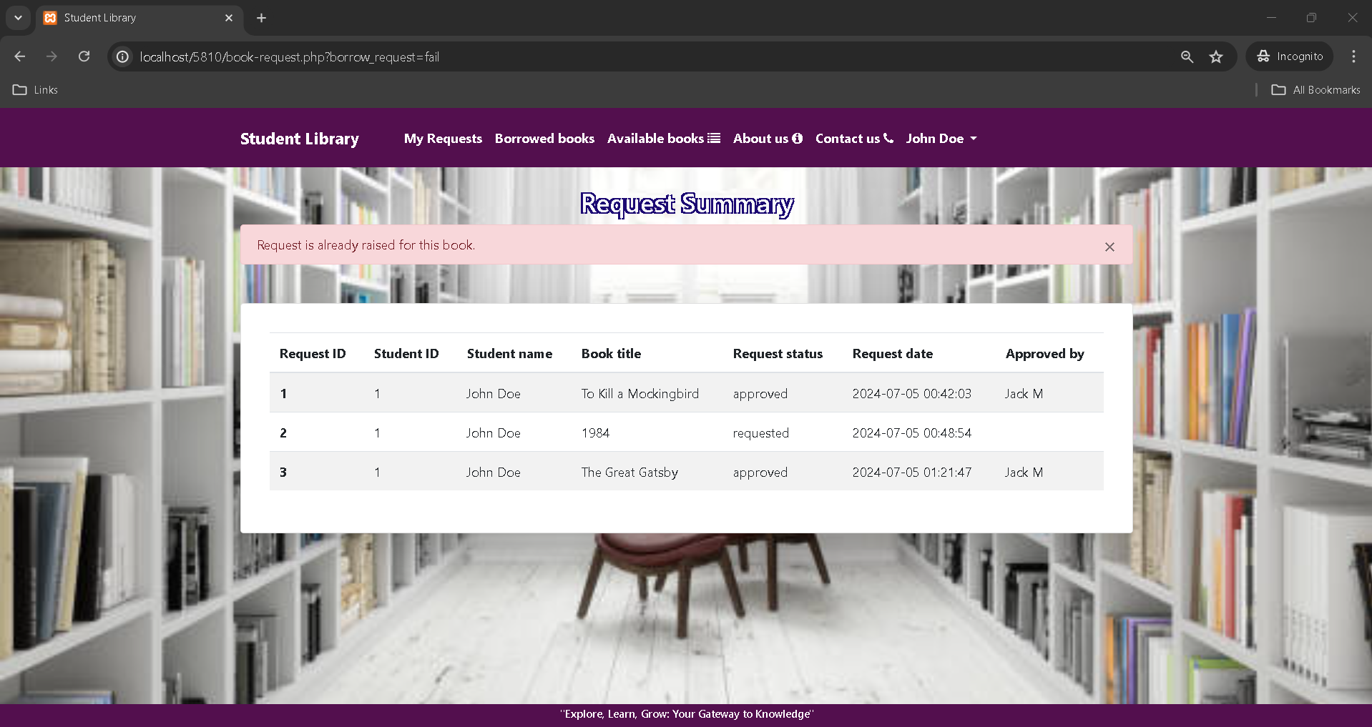
Screenshots of implementation – student view

Slide 16
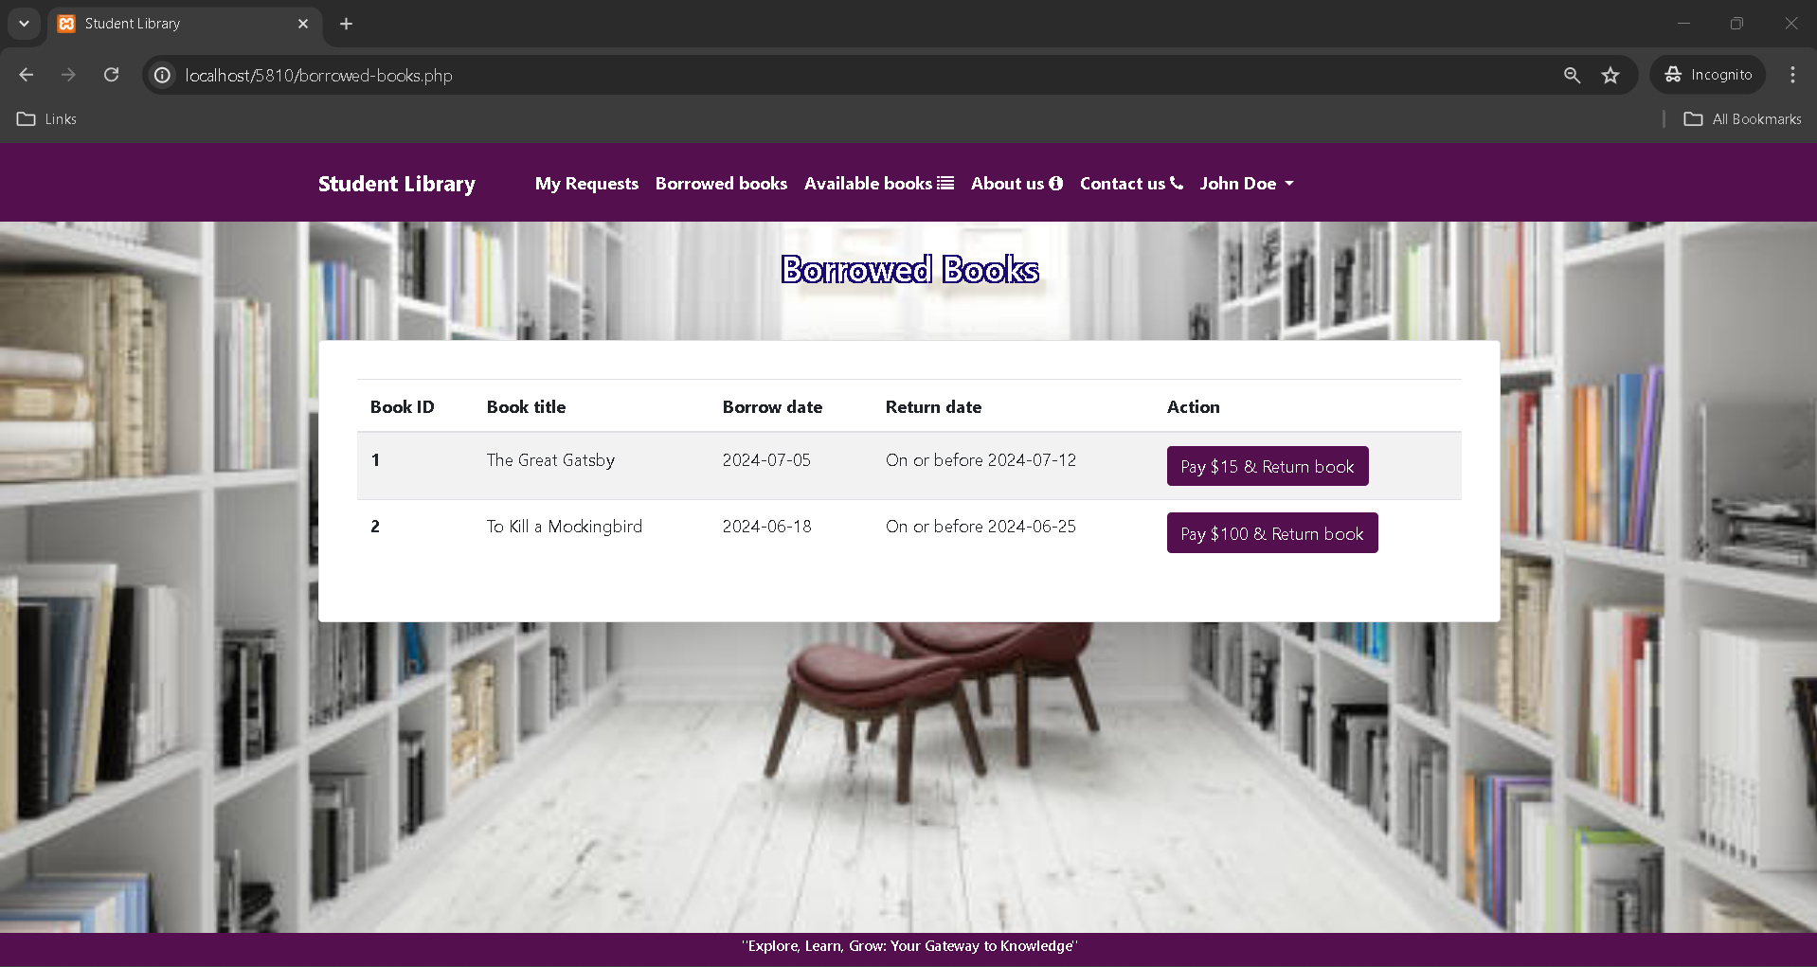
Screenshots of implementation – student view

Slide 17
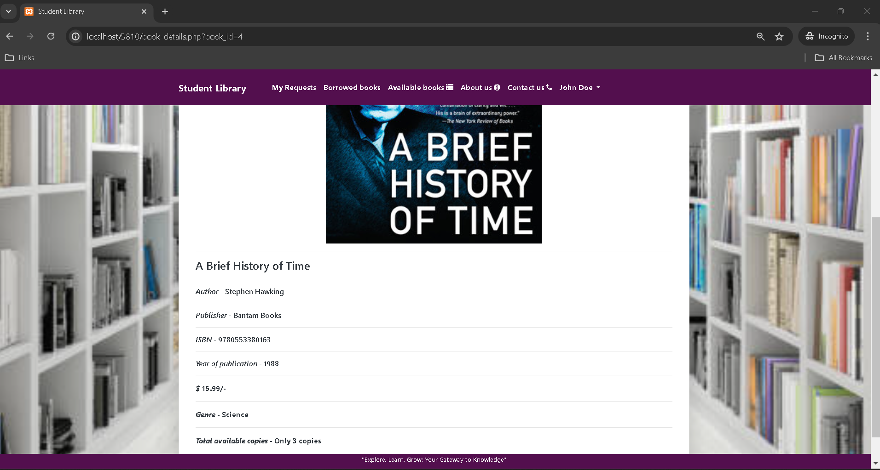
Screenshots of implementation – common view

Slide 18

Screenshots of implementation – librarian view

Slide 19
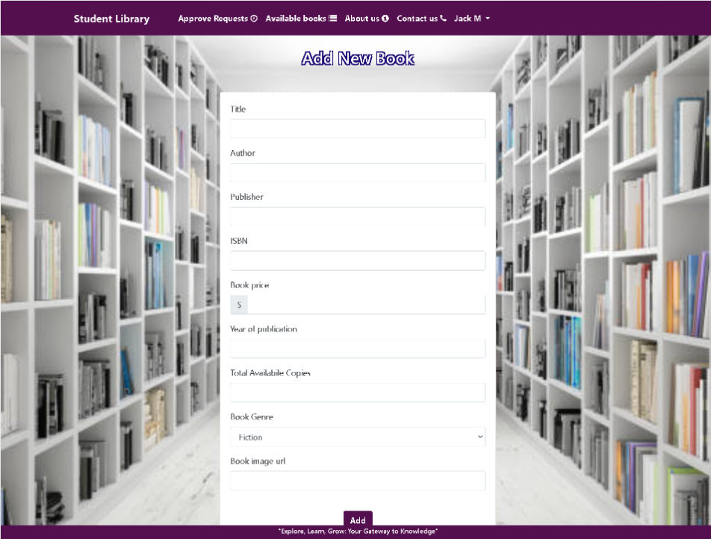
Screenshots of implementation – librarian view

Slide 20
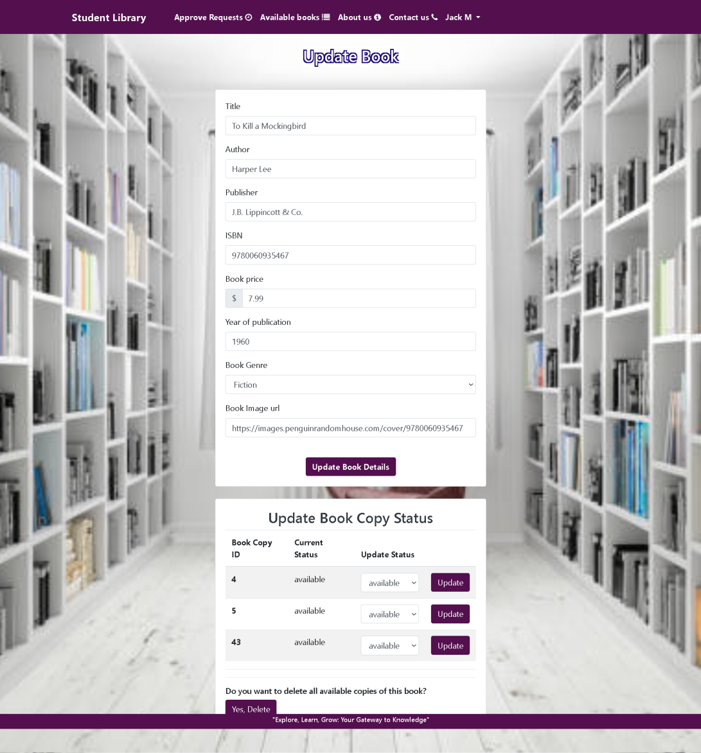
Screenshots of implementation – librarian view

Slide 21
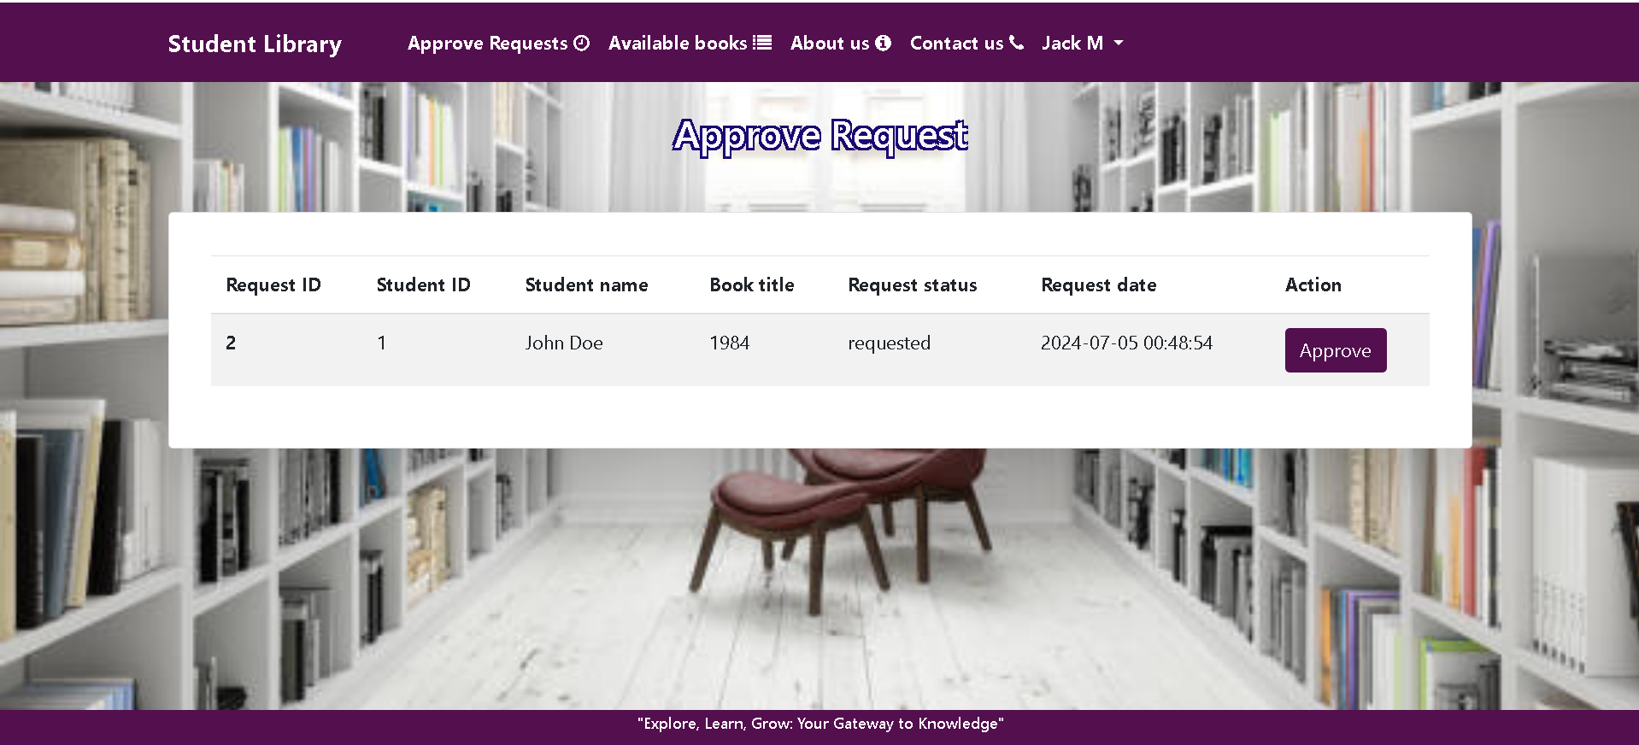
Screenshots of implementation

Slide 22
conclusion
Library management system is very important for managing the day-to-day task of library.
The system is designed effectively by keeping all the functional and non functional requirements and also our keys stakeholders in mind.
The main intention was that the system should be easily accessible by the users, which was achieved by designing good web user interface and implementing proper system interaction logic.

Slide 23
Thank you

